Slide 1

Predicting Loan Repayment
using
Decision Tree Classification
Aastha Agrawal 01
Abhijeet Katiyar 02
Shivaansh Agarwal 24

Slide 2
Contents:
Business Problem Understanding
An Overview of Dataset
Data Pre-Processing
Exploratory Data Analysis
Model Building & Evaluation (CART & C5.0)
Graphical Evaluation of Models
Conclusions
Language Used: R

Slide 3

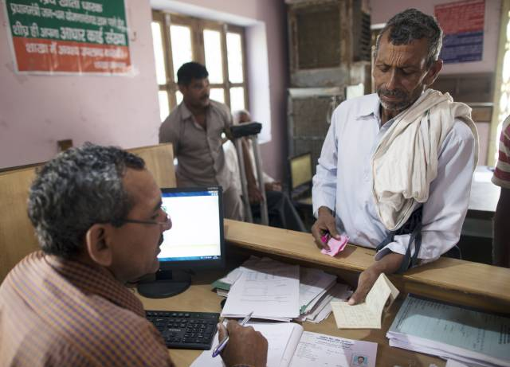

Business Problem Understanding
How risky is the borrower?
Given the borrower’s risk should the loan be provided to him?
Notes:
The two most critical questions in the lending industry are:
How risky is the borrower? i.e. if the lender lends money to the borrower what is the likelihood that he will repay it.
Given the borrower’s risk, should the loan be provided to him?
So traditionally this work of approving the loans was done by the employees of the lending firm, (NEXT)
where the Customer, to apply for a loan would first submit his/her documents to the Lending firm,
where the employee after going through the applicant’s documents decided whether to approve the loan or not.
BUT since this process of loan approval required a lot of human time and effort,
and moreover the process of loan approval was not that accurate, the companies decided to automate the lending process,
in which the customer would just need to fill an Online Form and get to know in real time whether he is eligible for loan or NOT.

Slide 4
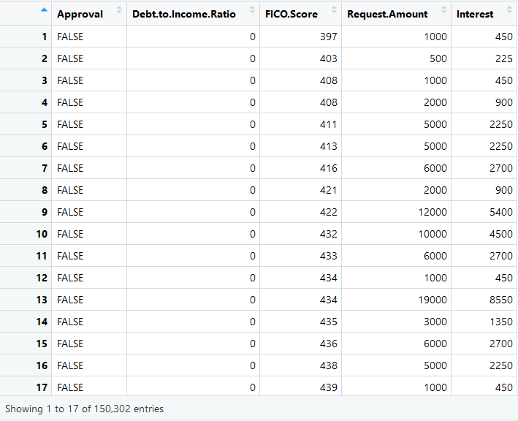
An Overview of the Dataset
Set of 150,302 bank loan applications for a 3-year term.
5 variables:
Approval
Debt To Income Ratio
FICO Score
Request Amount
Interest
Notes:
Approval: Whether the Loan was approved or not.
Debt To Income Ratio: It is a personal finance measure that compares an individual’s debt payment to his or her overall income.
The debt-to-income ratio is one way lenders, including mortgage lenders, measure an individual’s ability to manage monthly payment and repay debts.
DTI is calculated by dividing total recurring monthly debt by gross monthly income,
and it is expressed as a percentage.
A debt-to-income ratio smaller than 36%, however, is preferable, with no more than 28% of that debt going towards servicing a mortgage.
While the maximum DTI will vary by lender, the lower the number, the better the chances
that an individual will be able to get the loan or line of credit he or she wants.
Fico Score: A FICO score is a type of credit score created by the Fair Isaac Corporation.
Lenders use borrowers' FICO scores along with other details on borrowers' credit reports to assess credit risk and determine whether to extend credit.
FICO scores take into account various factors in five areas to determine credit worthiness: payment history, current level of indebtedness, types of credit used, length of credit history and new credit accounts.
FICO scores range between 300 and 850.
In general, scores above 650 indicate a very good credit history.
In contrast, individuals with scores below 620 often find it difficult to obtain financing at favorable rates.
To determine credit worthiness, lenders take a borrower's FICO score into account but also consider other details such as income, how long the borrower has been at his job and type of credit requested.
Request Amount: The amount requested by the Borrower.
Interest: The interest represents a flat rate of 15% times the request amount, times 3 years, and should not be used to build prediction models.

Slide 5
Data Preprocessing
No Missing values in the Dataset
Summary Statistics of FICO Score Attribute
Attribute | No. of NULL Values
Approval | 0
Debt To Income Ratio | 0
FICO Score | 0
Request Amount | 0
Descriptive Statistics | Value
Minimum | 371
1st Quartile | 647
Median | 684
Mean | 672
3rd Quartile | 714
Maximum | 869
Notes:
FICO Score only from 300 to 850 but here 869: Therefore We need to remove the values above 850.

Slide 6
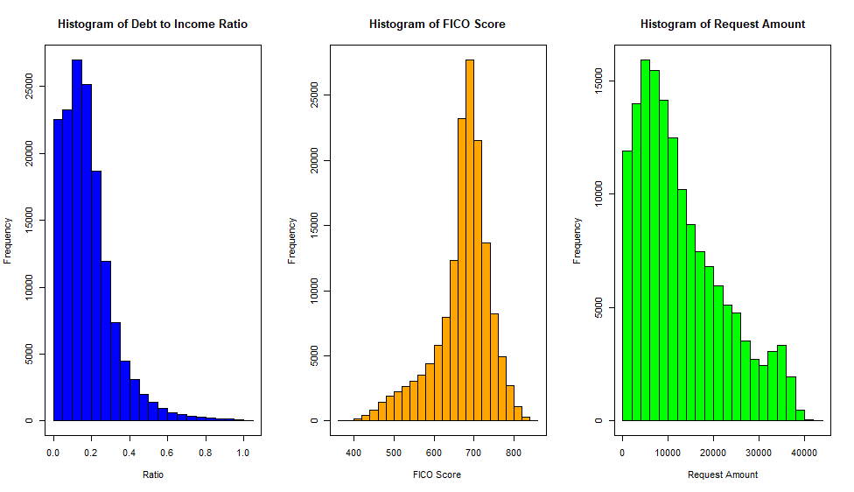
Exploratory Data Analysis
Notes:
Debt to Income Ratio:
If the customer has a Ratio lower than 0.36 or 36% then only he is eligible for a loan.
So in the above histogram we can see that the customers having ratio more than 36% are less likely to get loans
FICO Score:

Slide 7
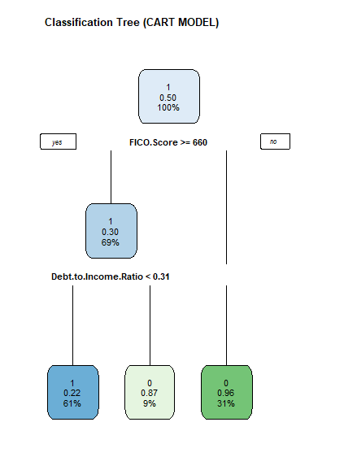

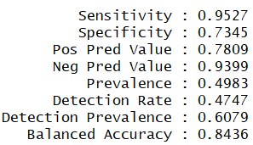
Model Building & Evaluation (CART Model)

Slide 8
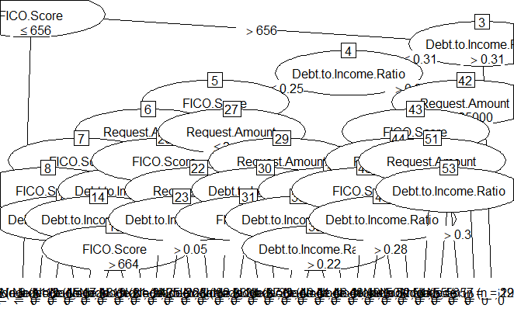

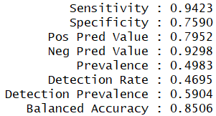
Model Building & Evaluation (C5.0 Model)

Slide 9
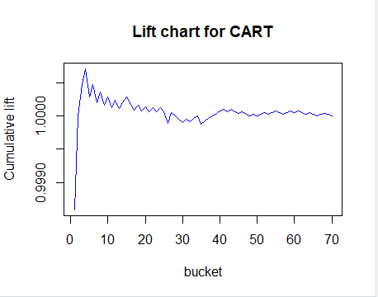
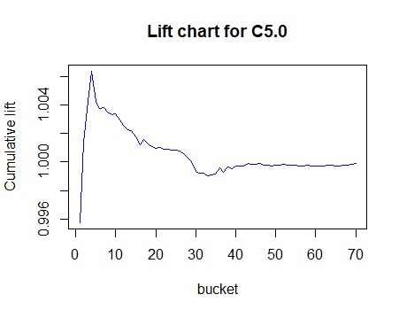
Graphical Evaluation and Comparison of Models
Lift Chart

Slide 10
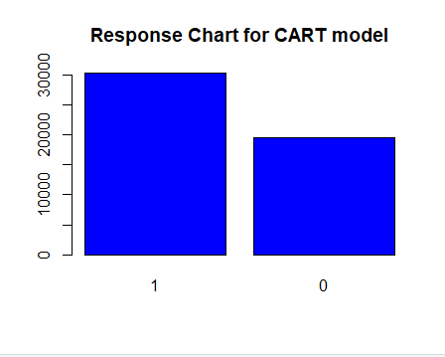
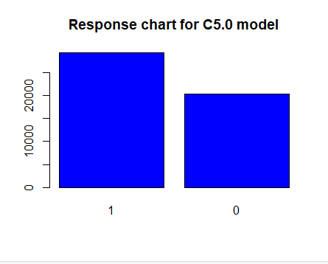
Graphical Evaluation and Comparison of Models
Response Chart

Slide 11
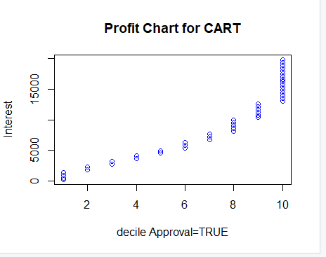
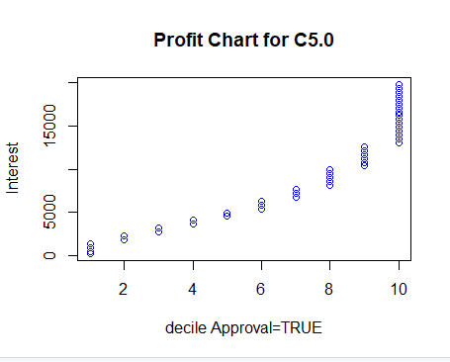
Graphical Evaluation and Comparison of Models
Profit Chart

Slide 12
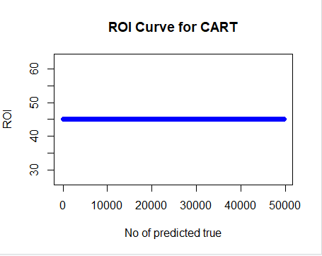
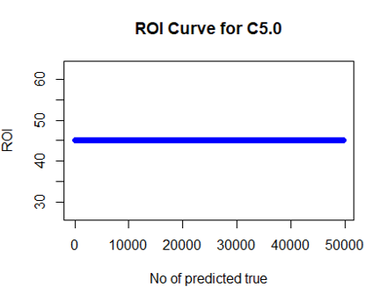
Graphical Evaluation and Comparison of Models
ROI Chart

Slide 13
Conclusions

Slide 14
Thank You

